Slide 1
Weekly report: Electrical Drivetrain
Week number: 4
Date: 14/10/2025
Supervisor: Prof. Dr.-Ing. Saiju
Group members: Aiswarya Vijayan, Vishranti Shivajirao Patil , Girish Mahadeo Padalkar, Cristina Milene Vergara Hernandez

Slide 2
List of contents
Concept of a converter in a wind turbine
Main function of a converter
Types of Converters
Our recommendation
How the converter is connected
IGBT overview
Conclusion & Next Steps
Aiswarya Vijayan
Electrical Drive Train/ Optimus Syria

Slide 3
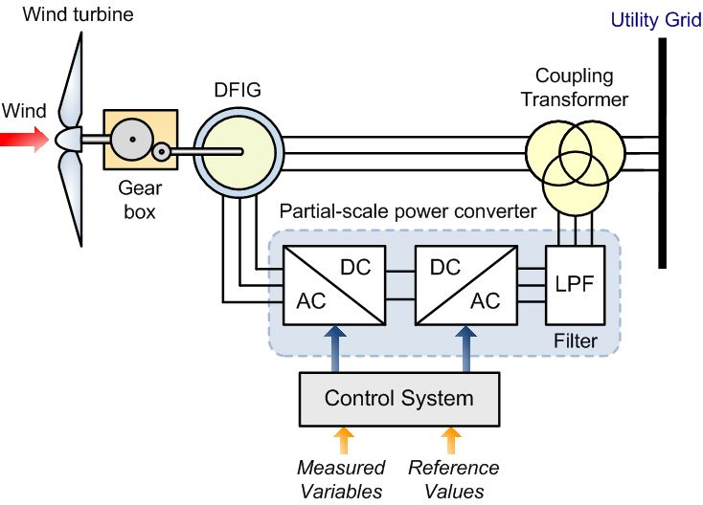
1.Concept of a Converter in a Wind Turbine
Source : https://www.researchgate.net/publication/315044381
Control_techniques_for_losses_reduction_in_wind_turbine_DFIG
Aiswarya Vijayan
Electrical Drive Train/ Optimus Syria

Slide 4
2.Main function of a converter
Power Conversion
Control of Power Flow
Voltage & Frequency Regulation
Protection & Grid Compliance
System Efficiency
Components:
Rotor-Side Converter (RSC): Controls torque and generator speed.
DC-Link Capacitor: Maintains stable DC voltage.
Grid-Side Converter (GSC): Manages grid connection and reactive power.
Aiswarya Vijayan
Electrical Drive Train/ Optimus Syria

Slide 5
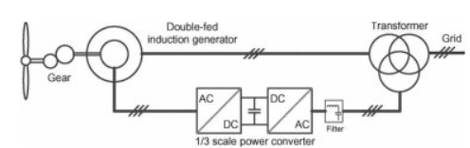
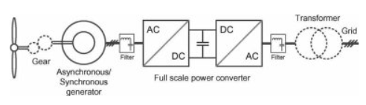
3.Types of converters
Source : www.academia.edu/35403755/ Power_Electronics_Converters_for_Wind_Turbine_Systems
Aiswarya Vijayan
Electrical Drive Train/ Optimus Syria

Slide 6
Partial-scale back-to-back Voltage-Source Converter (VSC) — Rotor-Side Converter (RSC) + DC-link capacitor + Grid-Side Converter (GSC), IGBT-based, with grid-side LCL filter. (Converter rated ≈ 25–30% of machine power → ~1.25–1.5 MW rotor-converter rating) Why this choice? — Key justifications 1. Cost & weight efficient 2. High energy capture 3. Proven, industry standard
4.Our recommendation
Aiswarya Vijayan
Electrical Drive Train/ Optimus Syria

Slide 7
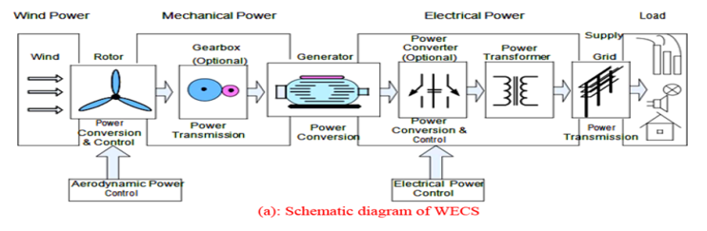
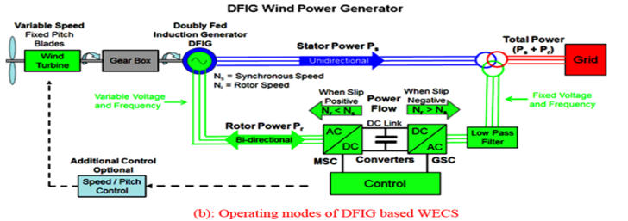
5.How the Converter is Connected
Aiswarya Vijayan
Electrical Drive Train/ Optimus Syria

Slide 8
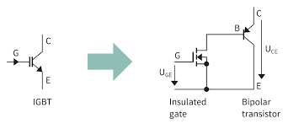
6.IGBT Overview
IGBT (Insulated Gate Bipolar Transistor) combines MOSFET input and BJT output features.
Used as a high-efficiency switch in converters for AC-DC and DC-AC conversion.
Advantages: high voltage/current capacity, fast switching, low losses, robust design.
Aiswarya Vijayan
Electrical Drive Train/ Optimus Syria

Slide 9
7.Next Step
Planning:
align our milestone planning with the other teams
Technical:
Generator: more detailed estimation of dimensions (size & rotational speed), Cost.
Converter: detailed study of IGBT ,Signal used to control IGBT and estimate detailed data of converter.
Market Survey of Generator and converter.
Aiswarya Vijayan

Slide 10

Bibliography
[1] S. Müller, M. Deicke, and R. W. De Doncker, “Doubly fed induction generator systems for wind turbines,” IEEE Ind. Appl. Mag., vol. 8, no. 3, pp. 26–33, May–Jun. 2002.
[2] F. Blaabjerg and K. Ma, “Wind energy systems,” Proc. IEEE, vol. 105, no. 11, pp. 2116–2131, Nov. 2017.
[3] M. Liserre, R. Cárdenas, M. Molinas, and J. Rodríguez, “Overview of multi-MW wind turbines and wind parks,” IEEE Trans. Ind. Electron., vol. 58, no. 4, pp. 1081–1095, Apr. 2011.
[4] H. Polinder, J. A. Ferreira, and B. B. Jensen, “Trends in wind turbine generator systems,” IEEE J. Emerg. Sel. Topics Power Electron., vol. 1, no. 3, pp. 174–185, Sep. 2013.
[5] G. Abad, J. López, M. Á. Rodríguez, L. Marroyo, and G. Iwanski, Doubly Fed Induction Machine: Modeling and Control for Wind Energy Generation. Hoboken, NJ, USA: IEEE Press/Wiley, 2011.
[6] Infineon Technologies AG, “FF1500R17IP5 IGBT module datasheet,” Infineon Technologies, Munich, Germany, 2023. https://www.infineon.com/dgdl/Infineon-FF1500R17IP5-DataSheet-v02_01-EN.pdf.
[7] Vestas Wind Systems A/S, “V150-5.0 MW technical brochure,” Vestas, Aarhus, Denmark, 2023. https://www.vestas.com/en/products/5-mw-platform.
[8] ABB Group, “Converters and drives for wind power applications,” ABB, Zurich, Switzerland, 2024. https://new.abb.com/drives/industries/wind.

